Slide 1
POTENTIAL ENVIRONMENTAL IMPACTS OF THE EMERGING OIL INDUSTRY IN GHANA
GROUP 3

Slide 2
Outline
Introduction
Value of oil industry in Ghana
Potential impacts of the Oil Industry on the environment
Case studies
Resolution
Conclusion

Slide 3
Introduction
Crude oil is made up of a mixture of hydrocarbons which exist in liquid form in underground reservoirs.
Ghana discovered commercial oil in 2007, and, subsequently, commenced production in 2010 (P. A. Sakyi, 2012).
Currently, the Jubilee Field in Tano Cape Three Points is highly explored for commercial purposes.

Slide 4
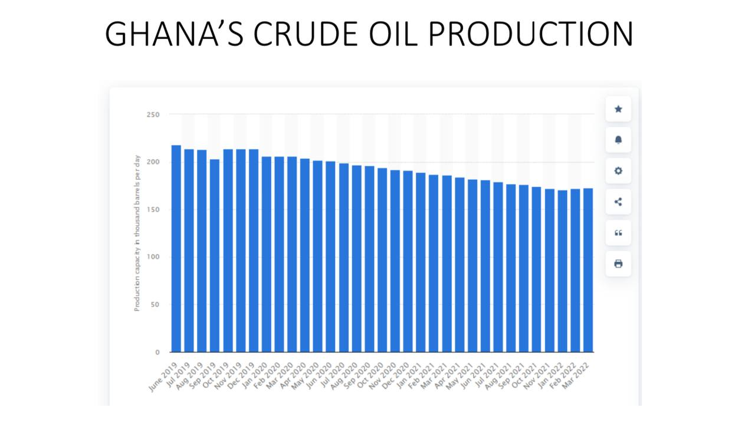
Value of the Oil Industry in Ghana
Fig.1 Chart of Oil production in Ghana.
As of August 2022, oil production capacity in Ghana stood at 177 thousand barrels.
The country accumulated 83 million US dollars and 100.4 million US dollars from oil revenue in January 2021 and June 2021 respectively (www.statista.com/statistics).

Slide 5
Potential Impacts of the Oil Industry on the environment
Proliferation of hydro-carbon oxidizing microbes including Marinobacter, Pseudomonas, Acinetobacter (Borzenkov, 2006).
Noise affects marine mammals like whales and dolphins who are affected by sound elevation due to their dependence on sound for reproduction, feeding and avoiding predators (Tyrack and Miller, 2002).

Slide 6
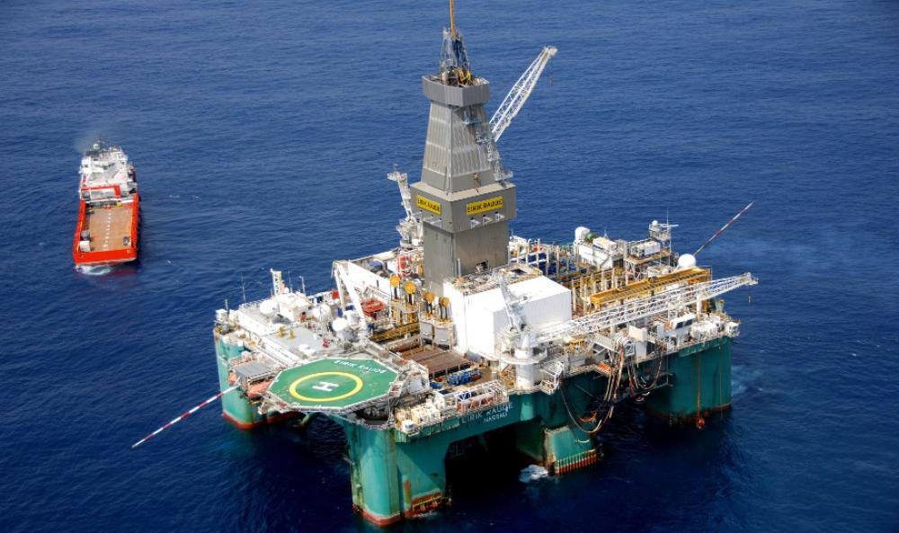
Potential Impacts of the Oil Industry on the environment
Habitat fragmentation and destruction.
Fig. 2 Jubilee Field under Tullow Oil Operations.

Slide 7
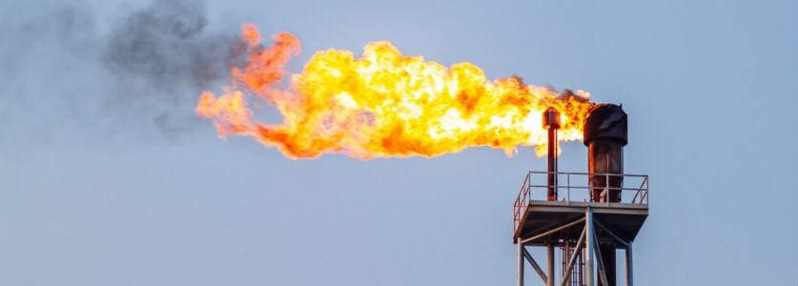
Potential impacts of the Oil Industry on the environment
Atmospheric emissions
Gas flaring has the potential to damage the Ankara Forest Reserve and the surrounding vegetation and farmlands located offshore the Jubilee Field (P.A. Sakyi, 2012).
Fig.3 An image of gas being flared.

Slide 8
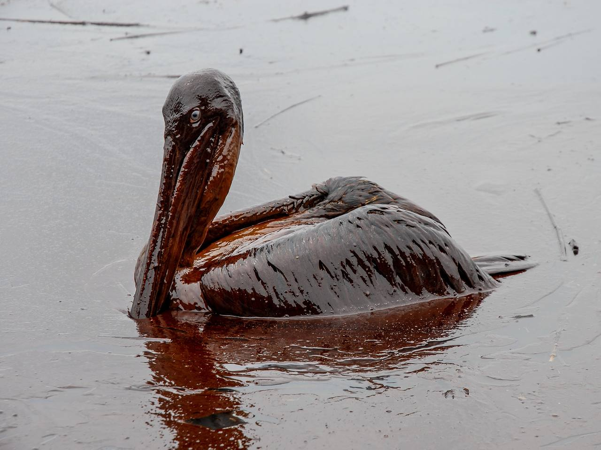
Potential impacts of the Oil Industry on the environment
Oil spillage causes trapping of the birds and also reduce amount of dissolved oxygen.
Fig. 4 Sea bird trapped during the Deepwater Horizon oil spillage.

Slide 9
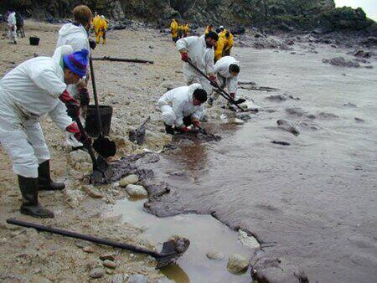
Case Study: Erika Oil Spillage
The oil spillage from Erika oil in 1999 resulted in the deaths of over 100,000 birds (BBC, 2000).
Fig. 5 Workers draining oil from the sea after the Erika oil spillage.

Slide 10
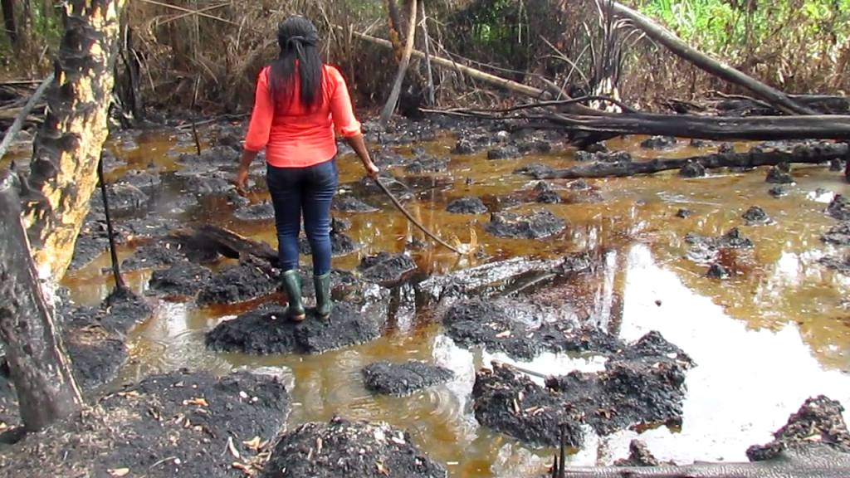
Case Study: Niger Delta Oil Spillage
Fig. 6 Oil spillage in Niger’s Delta.
Oil spillage and waste discharge into waterbodies have seriously damaged the Niger Delta’s mangroves, impairing the coastal ecosystem of this part of Nigeria (Pyagbara, 2007 & Amnesty International 2009).

Slide 11
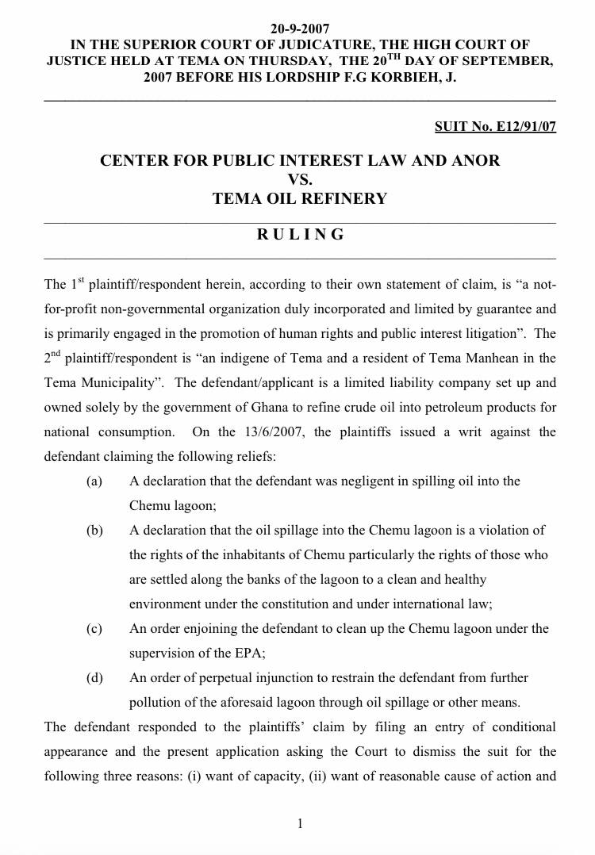
Case Study: Ghana
In 2007, the Tema Oil Refinery(TOR) was sued by the indigenes of Chemu for spilling oil into the Chemu lagoon resulting in a low fish catch and destruction of the fauna and flora in the lagoon.
Fig.7 lawsuit against TOR.

Slide 12

Resolution
Ghana has no comprehensive environmental legislation targeting the oil industry.
Legislations should focus on these aspects:
The prescriptive approach
The performance-based approach
Recommended administrative and institutional support

Slide 13
Conclusion
Unregulated activities by the oil industry can potentially destroy habitats and damage biodiversity, and this requires that Ghanaian policy makers take a closer look at national sustainability strategies that will ensure sustainable exploitation of oil without adverse effects on the environment.

Slide 14
References
Amnesty International (2009). Nigeria: Petroleum, Pollution and Poverty in the Niger Delta. Amnesty International Publications. Index: AFR 44/017/2009. FRP143. 143 pp.
British Broadcasting Corporation (2000). Oil spill damage worsens. http://newss.bbc.co.uk/2/hi/Europe/592378.stm (Accessed: 18/10/2011)
Pyagbara L. S. (2007). The adverse impacts of oil pollution on the environment and wellbeing of a local indigenous community: the experience of the Ogoni people of Nigeria. United Nations Department of Economic and Social Affairs Report. PFII/2007/WS.3/6.

Slide 15
References
Tyack P. L. and Miller E. H. (2002). Vocal anatomy, acoustic communication and echolocation. In Marine Mammal Biology. (A.R. Hoelzel, ed.), pp. 142-184. Blackwell Science Ltd., Oxford, UK.
Kloff S. and Wicks C. (2004). Environmental management of offshore oil development and maritime oil transport. A background document for stakeholders of the West African Marine Eco Region. IUCN working paper.
P. A. Sakyi, J. K. Efavi, D. Atta-Peters, and R. Asare (2012). Ghana’s Quest for Oil and Gas: Ecological risks and Management Frameworks. West African Journal of Applied Ecology, Vol. 20(1).

Slide 16
References
I.A. Borzenkov et al., 2006. The properties of hydro-carbon oxidizing bacteria isolated from the oilfields of Tatarstan, Western Siberia, and Vietnam. Microbiology 75, 66-72. doi: 10.1134/S0026261706010127.

Slide 17
Group members
9207519 ENNINFUL, Edith
9199719 ANAAFI, Boateng Micheal
9214819 OFOSU, Christa Afua
9196019 ADU, Abena Owusu
9200019 ANNAN, Nana Efua Afon
9204619 BOAKYE, Lordina Serwaa
9204219 BANGYA, Lois Mbamah
9205419 BOATENG, Williams
9195819 ADOMAKO, Linford Dwamena
9198919 AMOAKOHENE, Rosemond

Slide 18
